Slide 1
INFORMATION AND ENTROPY

Slide 2

What is Information?
It is a measure that quantifies the uncertainty of an event with given probability - Shannon 1948.
For a discrete source with finite alphabet X = {x0, x1, . . . , xm-1} where the probability of each symbol is given by P(X = xk ) = pk
If logarithm is base 2, information is given in bits.

Slide 3
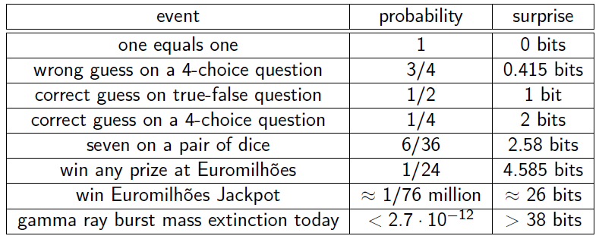
It represents the surprise of seeing the outcome (a highly probable outcome is not surprising).

Slide 4
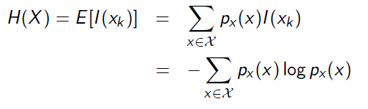
Entropy
Expected value of information from a source.

Slide 5

Entropy of binary source
Let X be a binary source with p0 and p1 being the probability of symbols x0 and x1 respectively.

Slide 6
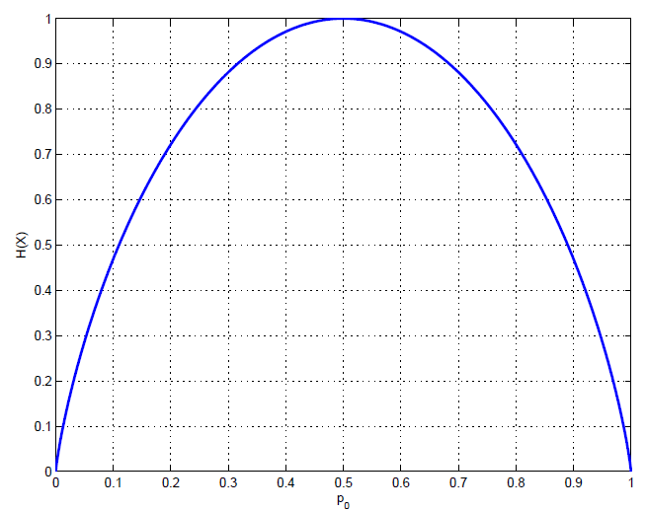

Slide 7

Joint Entropy
The joint entropy of a pair of random variables X and Y is given by:

Slide 8
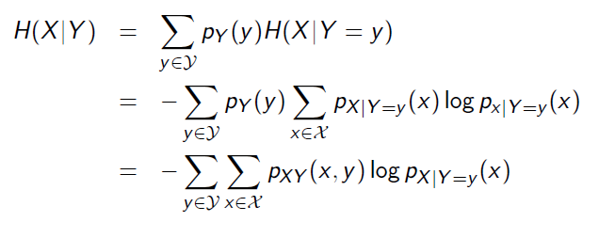
Conditional Entropy
Average amount of information of a random variable given the occurence of other.

Slide 9


Chain Rule of Entropy
The entropy of a pair of random variables is equal to the entropy of one of them plus the conditional entropy.
Corollary

Slide 10
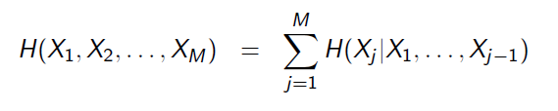
Chain Rule of Entropy: Generalization

Slide 11


Relative Entropy: Kullback-Leibler Distance
Is a measure of the distance between two distributions.
The relative entropy between two probability density functions pX (x) and qX (x) is defined as:

Slide 12
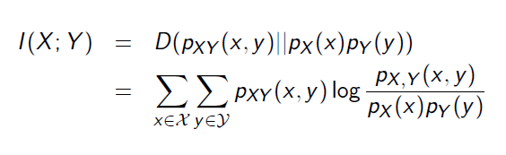
Mutual Information
The mutual information of two random variables X and Y is defined as the relative entropy between the joint probability density pXY (x, y) and the product of the marginals pX (x) and pY (y)

Slide 13
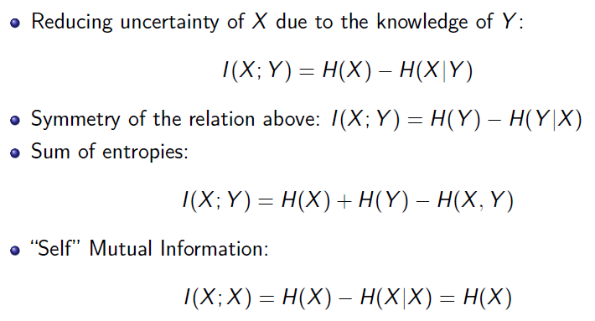
Mutual Information: Relations with Entropy

Slide 14
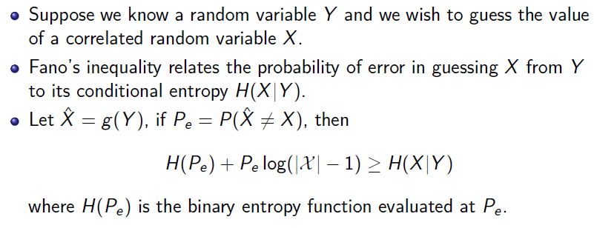
Fano’s Inequality

Slide 15
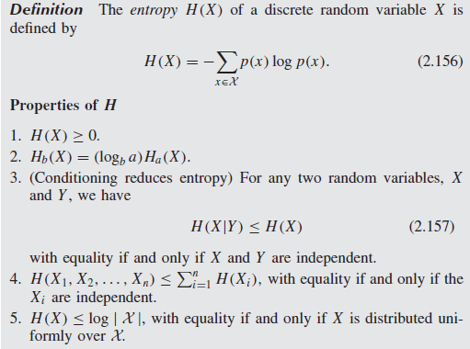
Summary

Slide 16
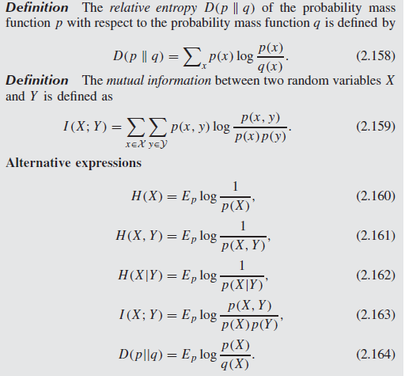
Cont...

Slide 17
END

